Slide 1
4.13 Microprogramming
61
Now we switch to looking at microprogramming.
In microprogrammed control, execution of microcode instructions produces control signal changes.
The microprogram converts each microcode instruction into control signals.
The microprogram is stored in firmware, which is a small piece of read-only memory also called the control store.
One microcode instruction is retrieved during each clock cycle.

Slide 2
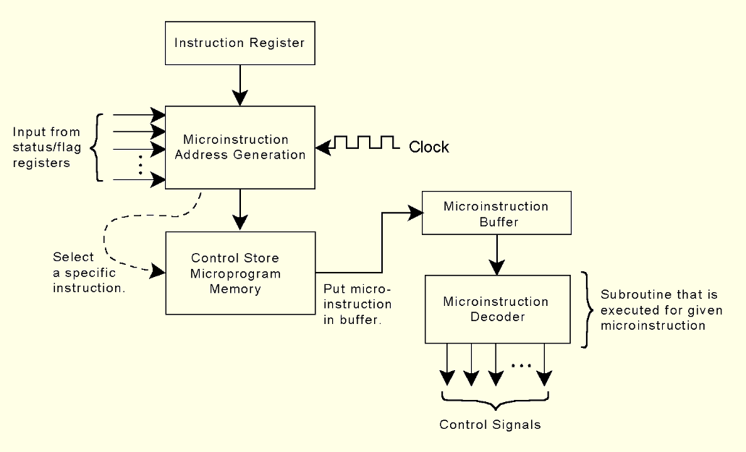
4.13 Microprogramming
62
This is how a generic microprogrammed control unit might look.

Slide 3
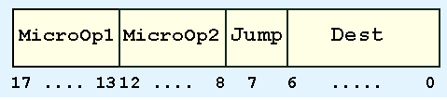
4.13 Microprogramming
63
If MARIE were microprogrammed, the microinstruction format might look like this:
MicroOp1 and MicroOp2 contain binary codes for each instruction. Jump is a single bit indicating that the value in the Dest field is an address that should be placed in the microsequencer, indicating which microprogram instruction should be executed next.

Slide 4
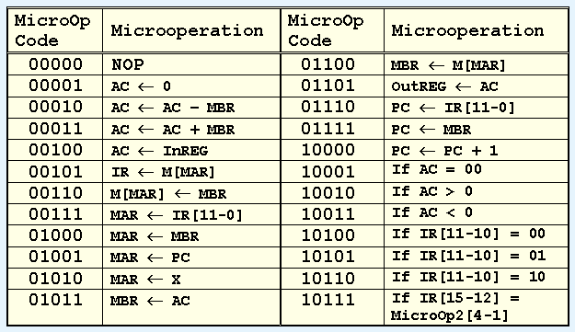
4.13 Microprogramming
64
The table below contains MARIE’s micro-opcodes along with their corresponding RTL:

Slide 5
4.13 Microprogramming
64b
Deletions from the table
  Don’t use 00111. It is a duplicate of 01010.
Additions to the table
  11000 MBR <- PC
  11001 MBR <- X
  11010 AC <- 1
  11011 PC <- AC
  11100 AC <- MBR

Slide 6
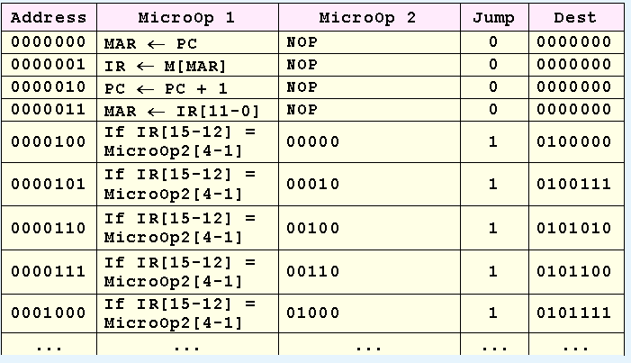
4.13 Microprogramming
65
The first lines of MARIE’s microprogram are given below (using RTL rather than the micro-opcodes for clarity).

Slide 7
4.13 Microprogramming
66
The first four lines contain the fetch (first 3 lines) and decode (line 4) steps of the execution cycle. The remaining lines are the beginning of a jump table.

Slide 8
4.13 Microprogramming
66b
The jump table entries indicate that if the high order bits of the IR (i.e., the opcode) have a given value, the microprogram will jump to the address where the remaining microoperations for that opcode will be found.
For example, LOAD has opcode 1. Looking through the jump table, we can see that a LOAD instruction will cause the microcode processor to jump to 010 0111.
At that address, it will find the fetch operand step for that instruction (if required) followed by the execute step, i.e., the RTL in microcode format:
010 0111 | MAR <- X | NOP | 0 | 000 0000
010 1000 | MBR <- M[MAR] | NOP | 0 | 000 0000
010 1001 | AC <- MBR | NOP | 1 | 000 0000

Slide 9
4.13 Microprogramming
66c
The last step of the encoded RTL will have a 1 in the JUMP field with a DEST of 000 0000. That will cause the system to jump to 000 0000, i.e., the beginning of the fetch cycle for the next operation.
The chart above shows the microcode in RTL for convenience, but we could also show it in binary.
010 0111 | MAR <- X | NOP | 0 | 000 0000
010 1000 | MBR <- M[MAR] | NOP | 0 | 000 0000
010 1001 | AC <- MBR | NOP | 1 | 000 0000
010 0111 | 01010 | 00000 | 0 | 000 0000
010 1000 | 01100 | 00000 | 0 | 000 0000
010 1001 | 11100 | 00000 | 1 | 000 0000

Slide 10
4.13 Microprogramming
67
A microprogrammed control unit works like a system-in-miniature. Microinstructions are fetched, decoded, and executed just like regular instructions.
This extra level of interpretation makes microprogrammed control slower than hardwired, but this is not important since computers are getting faster every day.
The advantage of microprogrammed control is that only the microprogram needs to be changed if the instruction set changes.
In fact, all modern machines are microcoded. We study hardwired machines first just to make it easier to understand the microcode architecture.

